Slide 1

SIDDAGANGA INSTITUTE OF TECHNOLOGY, TUMKUR
DEPARTMENT OF COMPUTER SCIENCE AND ENGINEERING
TOPIC:
“DRIVER DROWSINESS DETECTION SYSTEM”
PRESENTED BY:
MUSKAN AGARWAL 1SI19CS083
ISHITA SAXENA 1SI19CS051
MEHUL BHARDWAJ 1SI19CS076
BATCH ID : B2
UNDER THE GUIDANCE OF
MRS. NOUSHEEN TAJ
Assistant Professor

Slide 2
AGENDA
Introduction
Motivation
Literature Survey
Problem Statement
Objectives
High Level Diagram
Tools And Platform
Expected Outcome
Conclusion

Slide 3
INTRODUCTION
Driving involves situational awareness, as well as, quick and accurate decision making.
Situational awareness is critical in driving, as direct attention is required to process the perceived cues.
Fatigue slows down human response time, which leads to inability in safe driving.
Humans may exhibit multiple symptoms and levels of fatigue, therefore one symptom may not singly and accurately be employed for fatigue detection.
Thus, research in the field of driver’s state monitoring has been developing very rapidly.
Many techniques and methods have been implemented by various companies for driver assistance.

Slide 4
INTRODUCTION
This project presents a brief review of existing techniques used until now in the field of fatigue detection drivers.
This system is designed to detect the drowsiness of the driver and alerts the driver through an alarm.
It focuses on the eyes and mouth of the driver and determines if the person is drowsy or yawning.
If the driver is Drowsy and close eyes for more than a certain period of time the alarm activates thus alerting the driver.

Slide 5
MOTIVATION
General survey shows that 20% of the fatal collisions involve fatigue.Fatigue, in general, is very difficult to measure or observe unlike alcohol and drugs.
The best solutions to this problem are awareness about fatigue-related accidents and promoting drivers to admit fatigue when needed.
The driver drowsiness detection system provides the similar functionality with better results and alerts the user on reaching a certain saturation point of the drowsiness measure.
A system for car safety and driver safety is presented only in the luxurious cars. Using drowsiness detection system, driver safety can be implemented in normal cars also.
It is an effective and a cost efficient approach to reduce accidents, safeguard driver’s life and ensures vehicle’s safety.

Slide 6
LITERATURE SURVEY
SI No. | Title | Author | Journal/ Conference | Adopted Method
1. | Drowsiness Detection with Machine Learning | Grant Zhong, Rui Ying, He Wang, Aurangzaib Siddiqui, Gaurav Choudhary | International Journal Of Engineering Research & Technology (IJERT) | From this project we used Convolutional Neural Network (CNN), Long Short-Term Memory (LSTM) Network, Transfer Learning.
2. | Driver Drowsiness Warning System Using Visual Information for Both Diurnal and Nocturnal Illumination Conditions | MarcoJavier Flores, JoséMaría Armingol, Arturo de la Escalera | EURASIP Journal on Advances in Signal Processing | The algorithm proposed for eye detection, face tracking, and eye tracking.
3. | Drowsy Driver Detection System | Kodali Sahithi | Macquarie University | This project helps in developing our knowledge in Neural Networks,Image and Video processing.

Slide 7
PROBLEM STATEMENT
Drowsy Driving has been one of the major causes behind the dangerous accidents occurring these days in the world.
In this busy world, it has become difficult to get sufficient sleep due to hectic schedules. According to the Statistics, around 2,50,000 number of drivers fall asleep daily while driving.
About quarter of the accidents in the world are due to sleep deprived driving.
One such solution which can curb the number of accidents due to drowsiness is by detecting if the driver is sleepy or not and using an alarm to alert them.
Through this project, an in-depth study of various existing techniques of fatigue in a driver, is studied, followed by developing a deep learning based model to accurately identify a driver’s state.

Slide 8
OBJECTIVES
To develop a drowsiness detection system by monitoring the eyes; it is believed that the symptoms of driver fatigue can be detected early enough to avoid a car accident. Detection of fatigue involves the observation of eye movements and blink patterns.
To increase traffic safety and to reduce the number of traffic accidents; numerous universities, research centers, automotive companies and governments are contributing to the development of the product for driver analysis using different technologies.
To provide cost efficient approach of drowsiness detection system that can be implemented in cheap cars/trucks.

Slide 9
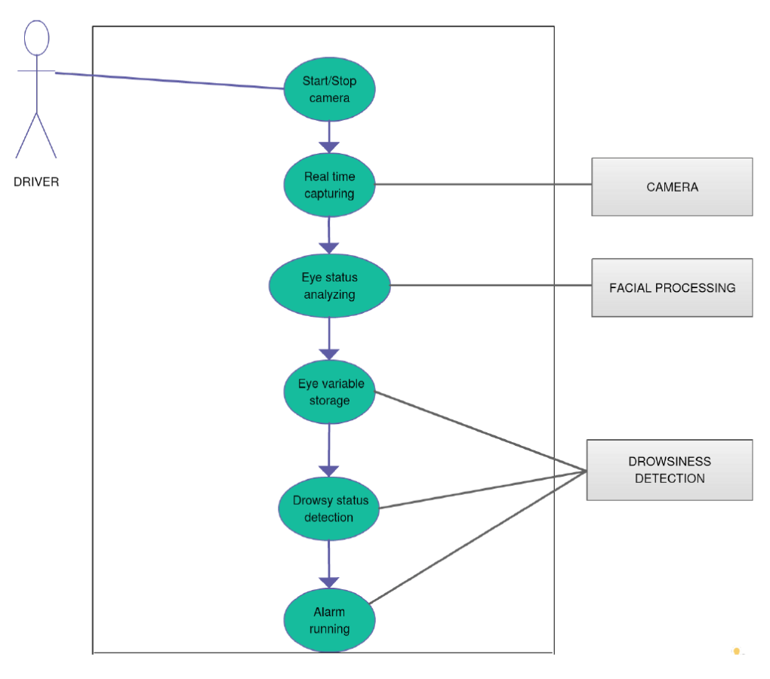
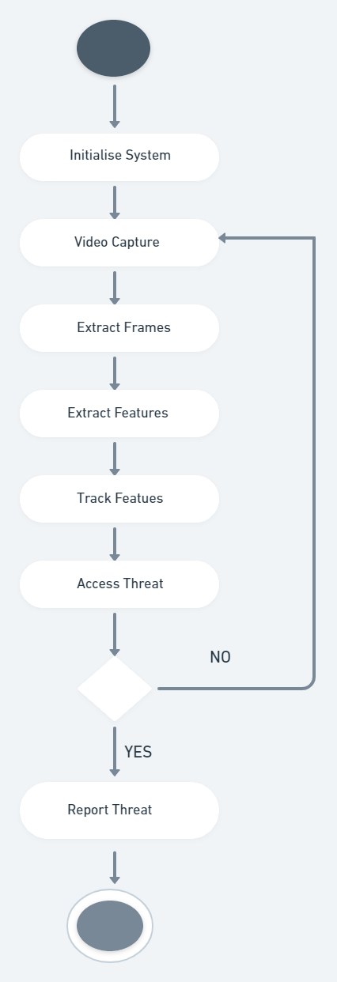
HIGH LEVEL DESIGN
Use Case Diagram
Activity Diagram

Slide 10
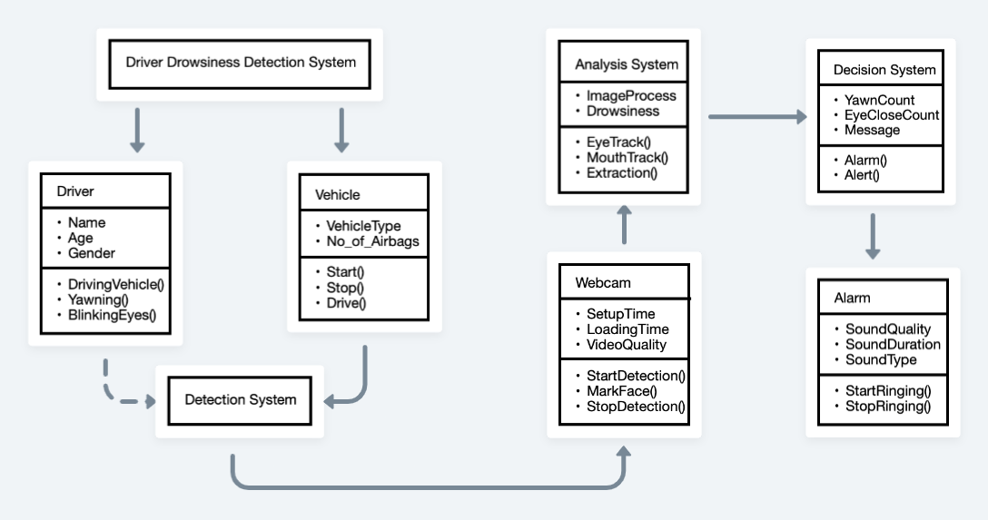
HIGH LEVEL DESIGN
Class Diagram

Slide 11
TOOLS AND PLATFORM
Software Requirements
Python
Libraries and Packages
OpenCV
OS: Windows or Ubuntu
Hardware Requirements
Laptop with basic hardware
Webcam
Technology used
Image Processing
Machine Learning

Slide 12
EXPECTED OUTCOMES
This method is proposed for driver drowsiness detection based on eye and mouth state. This determines the state of the eye that is drowsy or non- drowsy and whether the person is yawning or not.
Face and eye region are detected using Predict and Detection algorithm.
We will make use of openCV library features for converting each image into pixel values to detect the state of driver's face. An EAR equation could be used to classify the driver as sleep or non- sleep.
The system works well even in case of drivers wearing spectacles and even under low light conditions if the camera delivers better output. Information about the head and eyes position is obtained through various self-developed image processing algorithms.
During the monitoring, the system is able to decide if the eyes are opened or closed. When the eyes have been closed for too long, a warning signal is issued. Processing judges the driver’s alertness level on the basis of continuous eye closures.

Slide 13
IMPLEMENTATION
The Webcam based Implementation includes various concepts like
Feature Extraction
Detection of Region of Interest
Eye blink and Yawn normalization
Alarm Alert
to detect the drowsy driver and build the detection system.
OpenCV library is extensively used to detect each image or frame in a video.
Each functionality used is discussed in detail further in this section.

Slide 14
ROLE OF OPENCV
OpenCV library provides all the Computer Vision functions required for Image and Video processing in a single library.
All the methods can be used by Importing the package in the coding environment. It provides methods to read,write and display images.
Each image is converted into numbers which are known as Pixel values with each number representing the pixel intensity.
Reading and writing the images is crucial in implementing this project and this functionality is made easy by the OpenCV library.

Slide 15
FEATURE EXTRACTION
After the detection of images and performing image processing i.e change color of the images as required, perform rotation and resizing if required we need to extract the features.
Here, we need to obtain the facial landmark points. This can be termed as a subset of shape prediction problems.
Our main objective is to determine the important facial features using the shape predictor methods provided and then focus on the region of Interest according to the project goals.
The Region of Interest in this project is Eyes and Mouth to determine whether the person has sleepy eyes or yawning constantly.

Slide 16
FEATURE EXTRACTION
The facial landmark points can be determined in two steps:
Localize the face on the images
To localize the face on the images, we utilize the inbuilt Deep Learning based algorithms. The algorithm uses the method of dlib facial landmark detection in this project to detect the face in the image and provide the (x,y) coordinates as landmarks of the face. This localizes the face with (x,y) coordinates i.e a bounding box of the face is determined in the image.
Detect the Region Of Interest(ROI)
After localizing the face, we need to locate the Region of Interest (locating specific features required) which in this project are Eyes and Mouth. We need to locate the Eyes to determine if the person is Drowsy and Mouth to determine if the person is Yawning to to alert the driver. This step labels the required parts of the face using their coordinates which can be used as needed according to the requirements of the project.

Slide 17
DLIB FACIAL LANDMARK DETECTOR
To detect the facial landmarks we utilized the Facial Landmark Predictor provided by Dlib Library. Dlib provides the inbuilt algorithm to detect the facial landmarks points.
This predictor starts by using a training set of manually labelled facial landmarks on an image. It specifies the (x,y) coordinates of the facial structure with each specific facial feature denoted with their indexes.
An ensemble of regression trees are trained on this training data to estimate the facial landmark positions.
The predictor used in the project was trained on a 68 point iBUG 300-W dataset.This pre-trained detector is used to estimate the location of 68 (x,y) coordinates used to map the facial structure.
These indexes of the coordinates can be visualized as below.

Slide 18
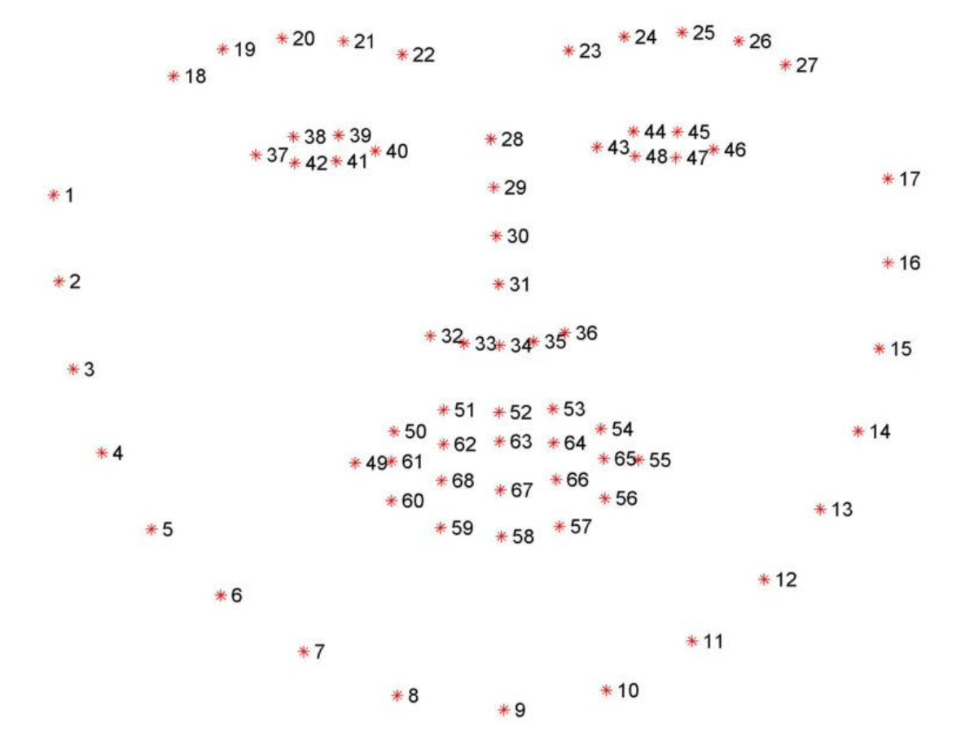
DLIB FACIAL LANDMARK DETECTOR
68 face landmark points Visualization

Slide 19
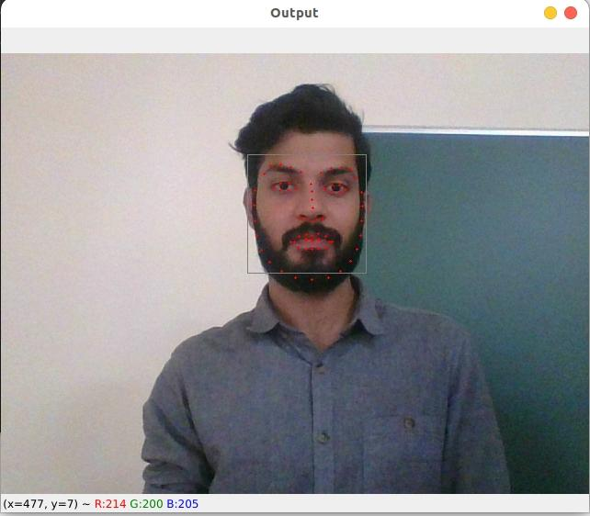
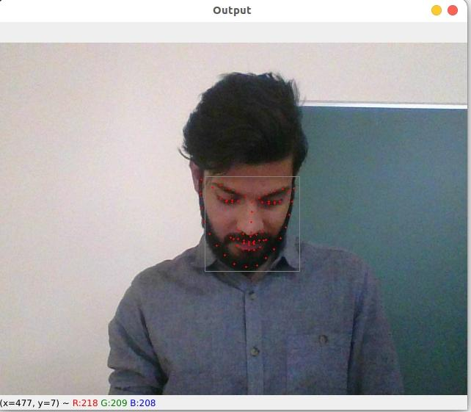
RESULTS

Slide 20
CONCLUSION
It completely meets the objectives and requirements of the system. The framework has achieved an unfaltering state where all the bugs have been disposed of.
It takes care of the issue of stressing out for individuals having fatigue-related issues to inform them about the drowsiness level while driving.
The model can be improved incrementally by using other parameters like blink rate, yawning, state of the car, etc. If all these parameters are used it can improve the accuracy immensely.
Same model and techniques can be used for various other apps like Netflix and other streaming services that can detect when the user is asleep and stop the video accordingly. It can also be used in application that prevents user from sleeping.
Notes:
I have achieved an unfaltered state.

Slide 21

THANK YOU.

